Slide 1
Logic State
Digital logic circuits have three logic states: high, low and floating(or high impedance)
The high-impedance state occurs when the pin is not pulled to a high or low logic level, but is left “floating" instead.
A good illustration of this is an unconnected input pin of a microcontroller.
It is neither in a high or low logic state, and the microcontroller might unpredictably interpret the input value as either a logical high or logical low.

Slide 2
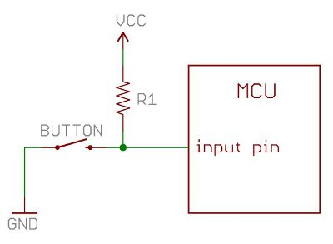
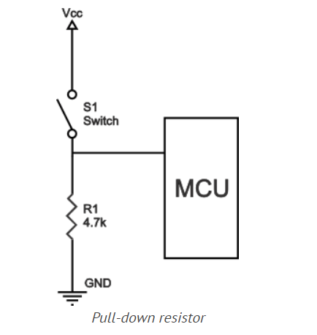
Pull up resistor

Slide 3
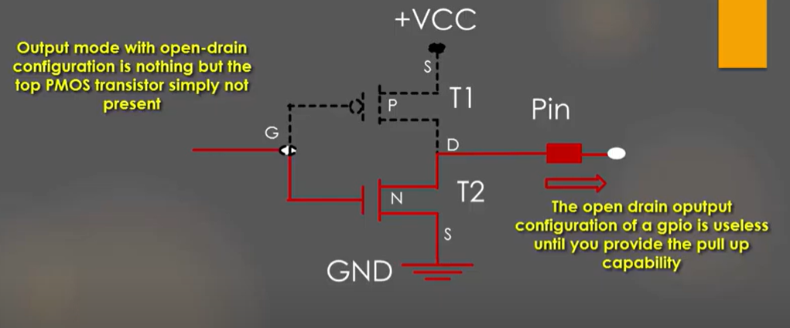
Open Drain

Slide 4
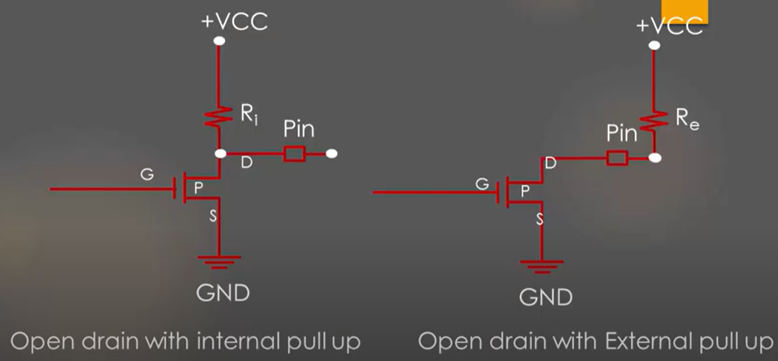
Open Drain

Slide 5
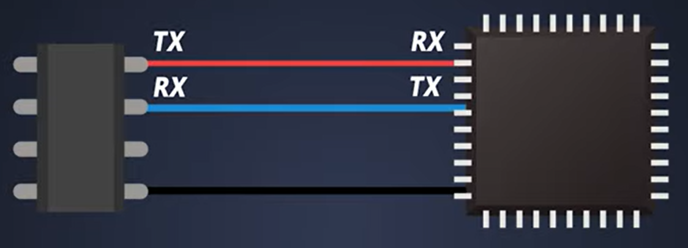
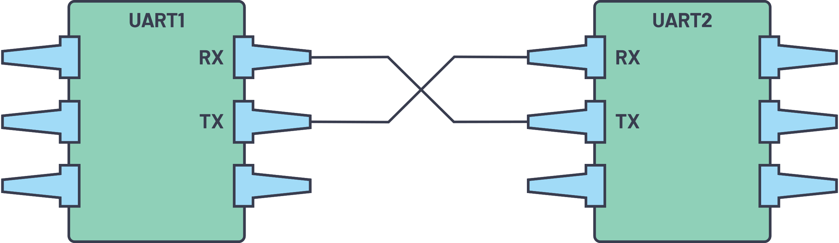
UART Communication
Hardware that converts parallel to serial data.
No specific port for UART communication can be used in conjugation with RS-232,RS-434 USB
When Tx and Rx is not transmitting it is held High (ideal state)
Components:
Baud Rate generator
Tx, Rx Register
Tx, Rx Buffer
FIFO Buffer memory

Slide 6
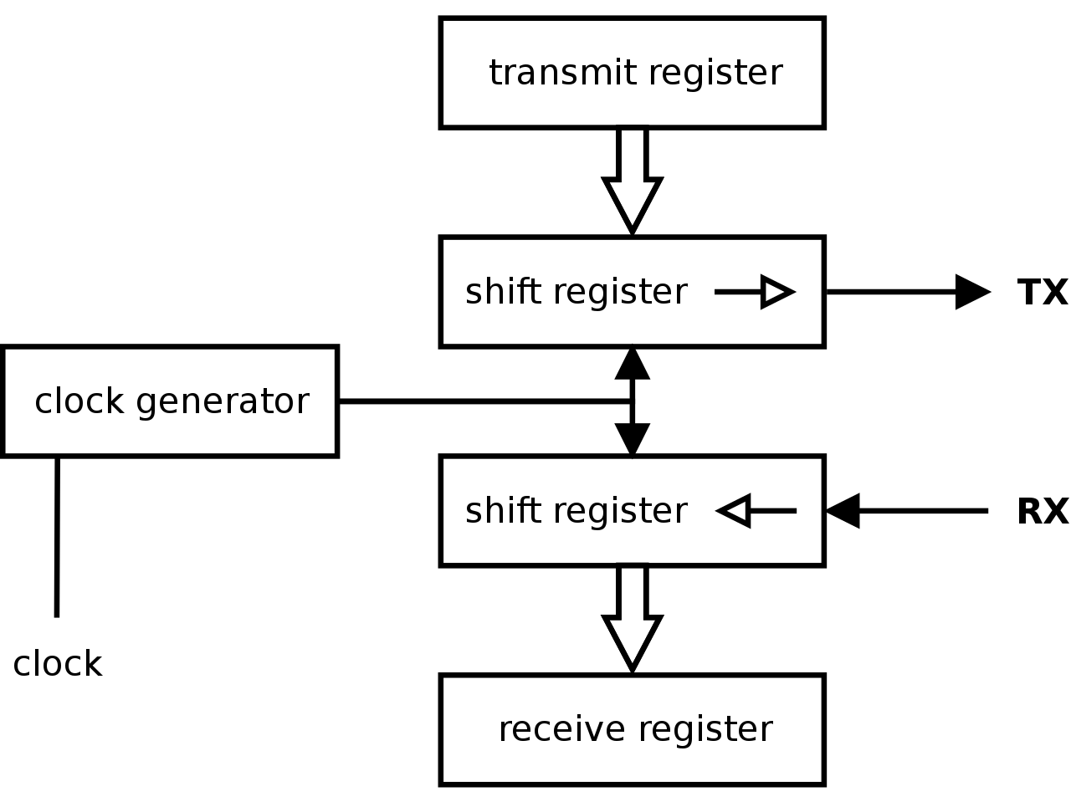
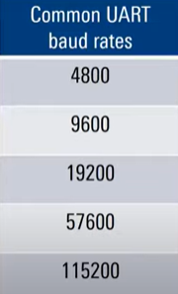
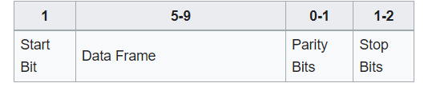
Used in earliest serial Protocols like RS-232,Modems
Still used for lower-speed and low throughput application

Slide 7
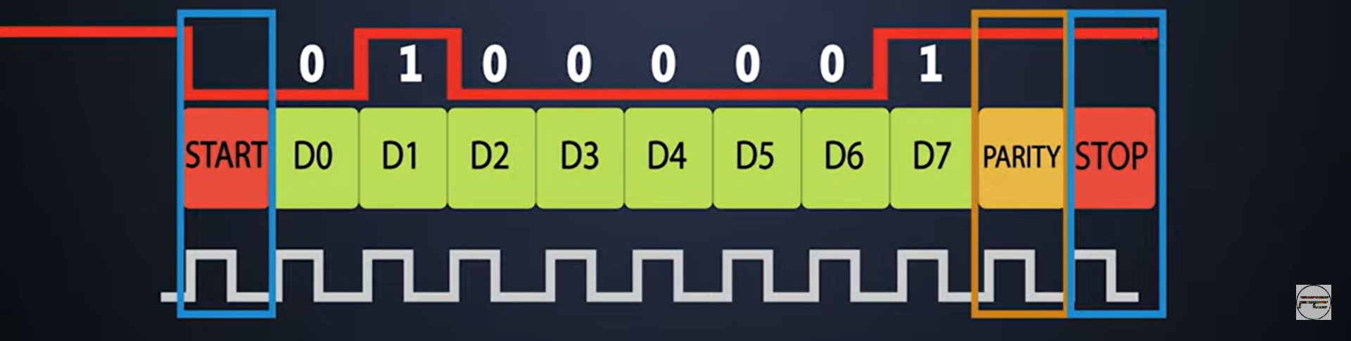
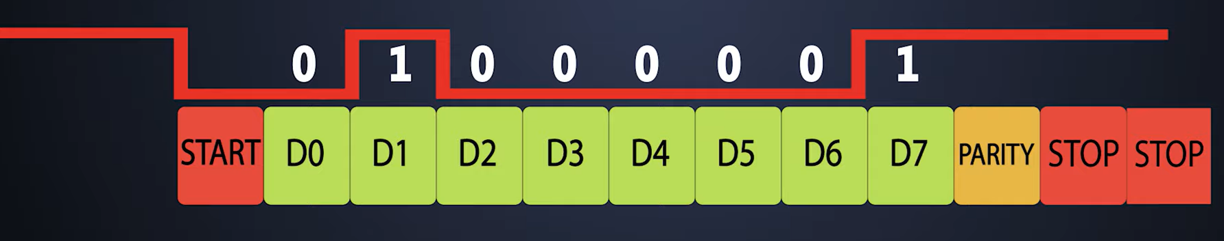
UART Communication

Slide 8
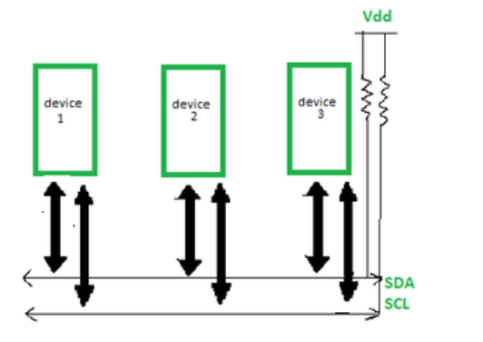
I2C Communication
To achieve serial data communication which are very close to each other
Multi-master capability
Communicates with slaves with slave address
Half duplex
Slave control over serial clock(clock stretching)
4 modes
Standard
Fast mode
Fast mode plus
High speed mode

Slide 9
I2C Communication
128(112) Devices with 7-bit addressing
1024(1008) Devices with 10-bit Addressing
The two lines are in open drain configuration.
The value of resistor is from 2k for high speed ~400kbps to 10k for 100kbps

Slide 10
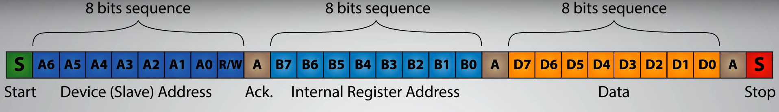
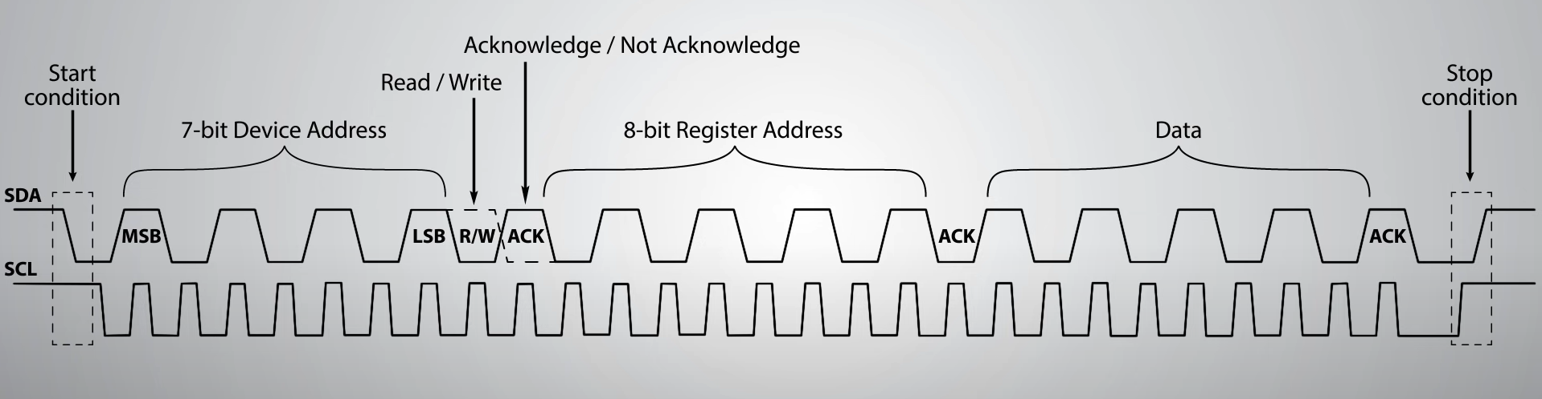
I2C Communication

Slide 11

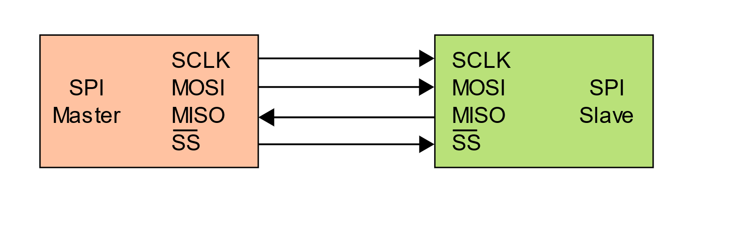
SPI COMMUNICATION PROTOCOL
Serial Peripheral Interface Communication Between ! Master and 1 or More Slave Devices
4 pins
MOSI
MISO
SCLK:- Output pin for master and input for slaves
SS:- Slave Select(Depending upon SPI and SS Setting Save is select)
SPI is used for Gather data from sensor at high frequencies, With Display and serial flash to RAM.
Data Communication line is high input impedance until ss is ground.
Half and Full Duplex Communication.
Serial resistor is used to store data as a buffer while sending and receiving data.

Slide 12
Spi Bus COnfiguration
It may consist Only 2- wires one for the clock Signal and other for the Synchronous Data Transfer
It is one Master and One Slave Configuration
Serial Clock
SCLK
SCLK
MOSI
MOSI
MASTER
SLAVE

Slide 13
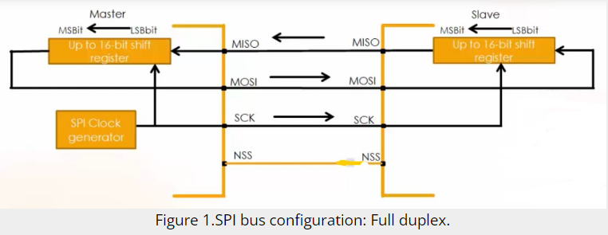
Full duplex data communication occurs during each clock cycle. The master shift register transmits the data to the slave on the MOSI line, and the slave receives it.
At the same time, the slave shift register sends the data to the master on the MISO line, and the master gets it.
Transmission may continue for any number of clock cycles. When complete, master idles the clock and releases the SS line.
So, in full-duplex communication shift registers of both master and slave are linked using two unidirectional lines between MOSI and MISO pins.
By default, SPI configures for full-duplex communication.

Slide 14
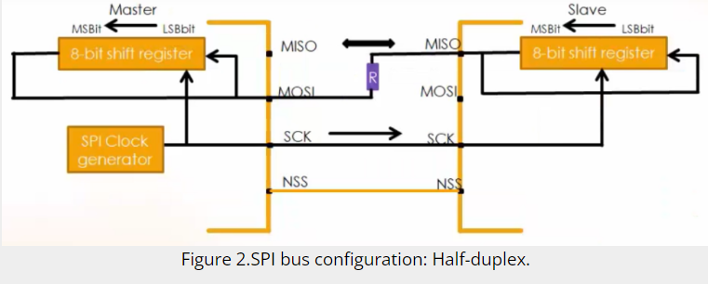
The SPI can communicate in half-duplex mode by setting the BIDIMODE bit in the SPIx_CR1 register.
In half-duplex data communication, one single cross-connection line is used to link the shift registers. In this data communication, there is only one data line.
The MOSI of the master connects to the MISO of the slave. And there must be one resistor in between a typical value may be 1kiloohm.
So, the transfer happens in the direction selected reciprocally by both the master and the slave.
That means, the slave transmits data on the MISO line, and the master receives it.
The MOSI line of the slave remains inactive.
Or the master sends the data on the MOSI line, and the slave gets it. The MISO line of the master remains inactive.

Slide 15
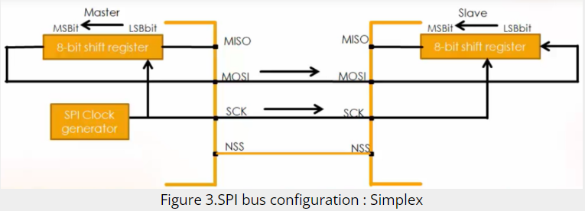
The SPI can communicate in simplex mode by setting the SPI in transmit-only or receive-only using the RX ONLY bit in the SPIx_CR2 register.
Simplex, as its name indicates the communication is in simple mode. There are two types of communication in simplex mode, one is transmitting only, and the other one is receiving only.
The master is in transmit mode, and the slave is in receive mode. The MOSI of the master connects to the MOSI of the slave. And both the MISO lines are disconnected.
In all of the above communications, the NSS pin is optional because only one slave considered

Slide 16
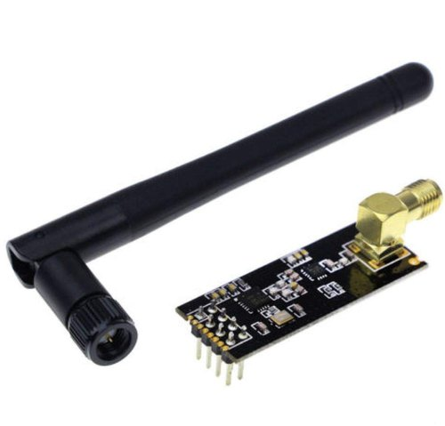
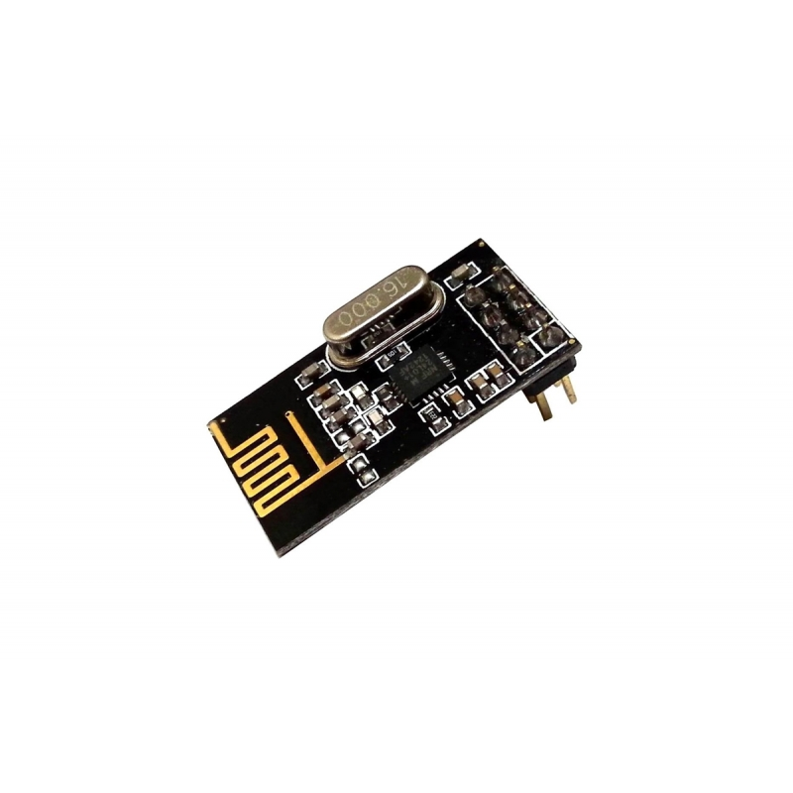
NRF24L01 MODULE

Slide 17
NRF24L01 MODULE
NRF24L01 is a wireless transceiver module (works on SPI Protocol), which is used for sending and receiving data at an operating radio frequency of 2.4 to 2.5 GHz ISM band.
This transceiver module consists of a frequency generator, shock burst mode controller, power amplifier, crystal oscillator modulator, and demodulator.
When transmitting power is zero dBm it uses only 11.3 mA of current, while during receiving mode, it uses 13.5 mA of current.
This module is designed for long distance and fast transmission of data.
Air data transmission rate of NRF24L01 is around 250kbps - 2 Mbps.
This module is designed to operate at 3.3 volts.
This module has an address range of 125 and it can communicate with six other modules. By using this feature, we can use it in mesh networks and other networking applications.
Its Emission Mode operating current is 115 mA and receive mode operating current is 45 mA.

Slide 18
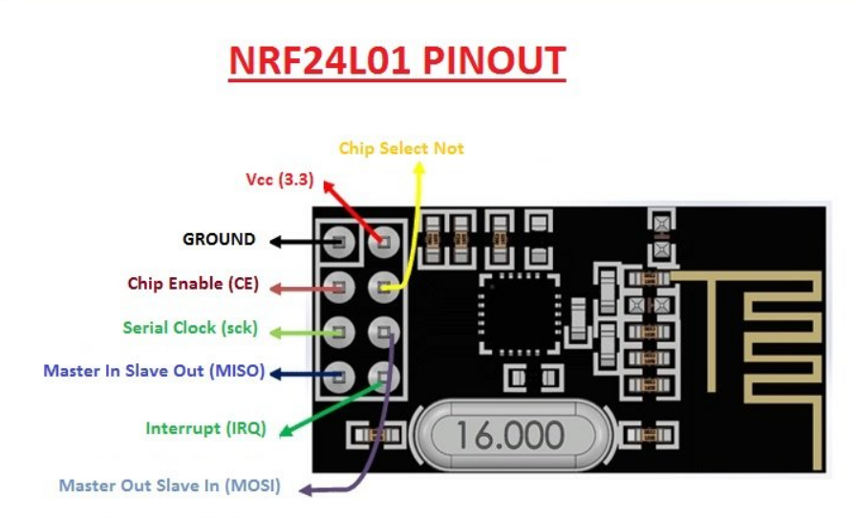
NRF24L01 MODULE

Slide 19
NRF24L01 MODULE
CS: This pin is chip enable, it used to activate RX or TX mode.
CNS: This pin is used for SPI protocol interfacing
SCK: This pin is used for serial clock provider.
MOSI: This is used to get data from a master microcontroller device and to send data to a slave device.
MISO: This pin is used to get data from a slave device and to send data to master device.
IRQ: This pin is used for interrupt data.

